Slide 1
GA/GRA Hiring Process (Faculty Hire Online Application)
George Washington University
Office of graduate Student assistantships and Fellowships
Rice Hall
Notes:
The purpose of this PowerPoint is to provide the user with an overview of how to utilize the faculty hire online application and answer some basic questions about the GRA payment process.

Slide 2
Online Hiring Process: Hire a GA/GRA: Introduction
In 2014, the Faculty Hire Application (Hire a GA/GRA) was redesigned to allow all GA and GRA hires to be processed online. The goal is to have all departments utilize the online Faculty Hire Application to reduce errors and get student hires in earlier and ultimately paid more efficiently.

Slide 3
GA/GRA Hire Process
Step 1- Hiring a GA/GRA using Faculty Hire Before submitting paperwork to hire a GA/GRA, the student must have been sent an award letter through the Graduate Automated Awards Application and must have accepted the GA or GRA award.
Complete the Employee Hire Form for the assistantship portion of the award-graduate salary account number 51122. All Graduate Assistants (GAs) and Graduate Research Assistants(GRAs) can be hired online through the Faculty Hire Application, Hire a GA/GRA. ( To request access see FAQs)
Payment paperwork can begin if:
You have established a position number on a grant does not have the same home index and home org. number (This can be checked by going to NBAPBUD) The position number is pooled.
Complete Graduate Teaching Assistants Program (GTAP) –GA Only Requirement
If this is a first time hire, GAs must be enrolled in GTAP. Previous hires should have already completed the requirement which will show up in SHACRSE under course UNIV 0250.DE . Report any new GAs to gradfell@gwu.edu .
The hire has been notified that they need to have an up-to-date I9 on file and complete a background check within 3 days of their start date
The student has no other active jobs in Banner with overlapping dates

Slide 4
Hiring Process (Hire a GA/GRA Online)
Who does what in Faculty Hire:
Roles
Users fall into the following categories, or roles:
1. Initiator—The person who initiates a GA or GRA re/appointment.
2. Approvers
Non Research-The Dean Approver within each school who approves or rejects GA/GRA (F8) hire forms.
Research-The sponsored research staff assigned as the approver for the grant charged and the Dean Approver
within each school who approves or rejects GRA (F8)Hire Forms.
3. OGSAF—The office that reviews and gives final approval to all appointments. Our office does not pay GAs or GRAs.
Payroll is responsible for dispensing payment to GAs and GRAs. This office receives a notification when the Faculty Hire Form has been approved and interfaced to Banner.
Notifications
Throughout the process of GA and GRA re/appointment using the online Faculty Hire Forms, notifications are sent to users depending on the actions taken. Users will get e-mails notifying them of these actions and can also access the notifications in the View Notifications page, which can be accessed from the Faculty
Hire Forms Main Menu.
What You Need to Know Before Completing the Forms:
There are a few things you need to know before completing these
forms. They are:
1. Start date of the appointment (must be the first day of the month)
2. End date of the appointment (must be the last day of the month)
3. GW ID of GA or GRA
4. If a sponsored research project, the Banner Home Organization number of PTA to which the position is assigned
5. If a University –funded GAship/GRAship or university sponsored project funded GRAship, the position number must be linked to the Banner Index where the salary should be charged (Index)
6. Who should approve the hire form appointment (Research- the appropriate SPA2 and Dean; University-funded Dean/Finance office)
Getting started
Log onto GWU Portal, https://my.gwu.edu and open Faculty Hire Application; HR Forms; then click on Faculty Hire Application

Slide 5
Hiring Process: Utilizing the Faculty Hire Online Application
Click the link to Create a GA/GRA Faculty Hire Form-Monthly Payroll and Employee Class F8
Notes:
Note on this screen that you can also see submitted hire forms and rejection notices when you open the tab “View Submitted/Approved Hire Forms and “View Notifications”.

Slide 6
Hiring Process: Utilizing the Faculty Hire Online Application
Enter data where you see (*) required fields. Click Save and Continue to advance to the next screen.
Please note you may see error message *Warning Faculty member not in PEAFACT; ignore it and proceed.
Notes:
This page is where you identify the basic information about the appointment, including the effective date of change and type of appointment, as well as the GRA being appointed.
The Effective Date of Change – This is the first field you input. Enter the effective date for the GRA appointment. You must enter the date in MM/DD/YYYY format, and the date must be the first day of the month in which the appointment is to take place. This is why start date of the position number is important because if it can not start before the position start date.
Date Prepared -This field defaults to the current date. It is read only and can not be changed.
Faculty GWID- Enter the GRA’s GW ID number. This will populate the name fields.
Type of Appointment- This is for informational purposes only, however it must be selected to advance to the next screen. For the appointment select either academic or semester and for summer select summer.

Slide 7
Hiring Process: Utilizing the Faculty Hire Online Application
If no address is provided, the permanent address will be substituted. The student must update their information on GWeb once hire paperwork has been processed. All hires must complete I-9 paperwork within the first 3 days of employment.
Notes:
This page self populates most of the fields and should populate an address if there is one in banner. Not having a W4 address will not stop processing the hire form in Faculty Hire; however, not having a W4 address does stop us from processing the hire in Banner. We are working on bypassing this issue in the future with IT.
In the meantime, please urge hires to update their W4 address in Banner or the default will be the permanent address.

Slide 8
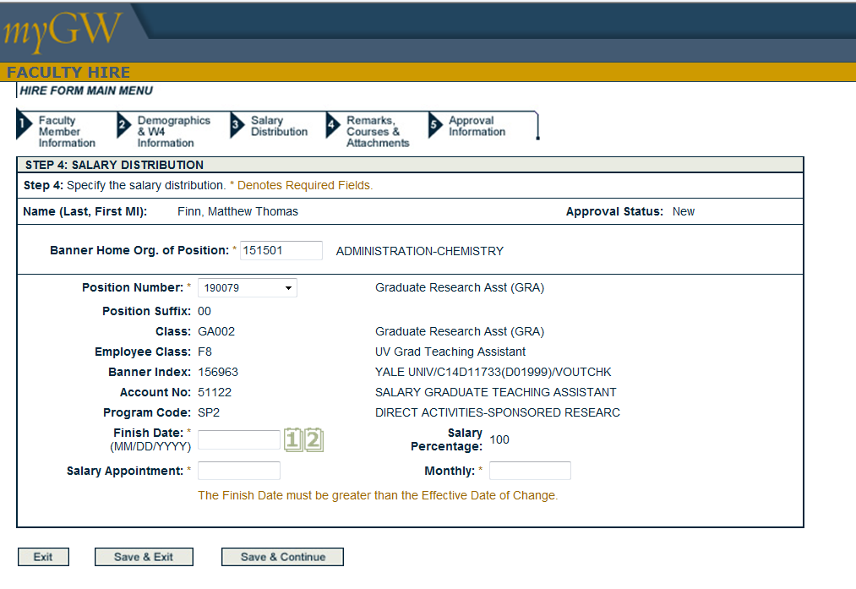
Hiring Process: Utilizing the Faculty Hire Online Application
Notes:
First you put in the home org. Once you pull down on position number several may appear so it is important to make sure you pick the right position number related to the sponsored project. If you chose the wrong position number you can see it to the right of the screen and go back to the position number drop down and select the appropriate one.
Next input end date, salary appointment and monthly salary. The monthly salary will populate after the salary appointment is input.

Slide 9
Hiring Process: Utilizing the Faculty Hire Online Application
Please note if you have any documentation to attach such as award letters and recommendation forms, attach them here.
If there is full F&A it must be included in the remarks. Any notes regarding lack of W4 or I9.

Slide 10
Hiring Process: Utilizing the Faculty Hire Online Application
Initiator name and contact information will populate.
Search for approver, then click submit.
Notes:
Please note on this screen there is a view option that you can print a copy for your records.
In selecting an approver, go to the search field and type in the name of the approver to search and then submit

Slide 11
Hiring Process: Utilizing the Faculty Hire Online Application
Notes:
For the secondary approver use the drop down menu on Select Group Approver and then click submit. Please note you must know who your approvers are first or you will route this to the wrong approver and hold up processing the hire.

Slide 12
Cancellation Processes-Assistantship
To cancel the assistantship, stipend and tuition payment- if the awardee’s enrollment status or eligibility changes: You must first terminate the job.
Complete a Change in Status(CIS) Request- located in Banner/HR forms/Terminations

Slide 13
Frequently Asked Questions
How do I get access to Faculty Hire Online Hire a GA/GRA? In order to gain access to the online workflow, Initiators and Approvers need to :
Complete the Banner Access Security Form. On that form indicate FACULTY HIRE.
Indicate the ECLS F8(GAs/GRAs)
List the orgs that you will be approving for
Once the form has all the appropriate signatures, it should be sent to HRIS. Mike Alford malford@gwu.edu or Annette Payne apayne@gwu.edu, in charge of Banner Security grants access.
If I do not have a position number what do I do? If there is no position number established contact The University Budget Office at ubo@gwu.edu. When requesting a new position number, submit the following for the type of appointment via email:
Do I need a separate position number for each GA/GRA hired? No. GA and GRA position numbers are pooled. More than one student can be hired on the same GA or GRA position number as long as their salaries are paid from the same Banner Charge Org. GAs and GRAs need different pooled position numbers even if charged to the same Banner Charge Org.
When do GAs/GRAs get paid? Salaries are monthly and paid on the last business day of the month (direct deposit is available for GA/GRAs to setup online or in the Faculty and Staff Service Center, Rice Hall; otherwise a paper check is issued)
When do I submit paperwork to ensure that the GRAs will receive on time payment, background checks, and the reduced insurance rate? Please refer to the following suggested schedule:
Summer-April 15 Fall- July 15 Spring- November 15
Notes:
In getting access to the Faculty hire, OVPR should follow the process for how they currently grant fiscal access.
Please note the effective date should be the first day of the month and not the date it is created.

Slide 14
Frequently Asked Questions
Do GA/GRAs receive tuition credit in the summer? No, both the Provost's Office and the Milken Institute School of Public Health will not offer tuition credits for GA/GRAs in the summer. PIs can write summer tuition into grant budgets, if allowed by the sponsor.
How many hours can a GA/GRAs work? A GRA is considered a .5 FTE and works 20 hours a week, including in the summer. Currently, the GW system cannot increase GA/GRAs to 28 hours a week in the summer. GA/GRAs are not to have any other positions either internal or external to GW.
When do GA/GRA appointments start and end?
Appointments can start any month on the first day of the month. The GA/GRA must be registered as a full-time student to begin the appointment.
If a PI wants to hire an incoming student as a GRA in the summer, the student must be accepted and enrolled in a summer class (the GRA does not have to be enrolled full time in the summer).
If a GRA is on a 12-month appointment, the GW system only allows for the fiscal year to be used for 12 consecutive months. Therefore, appointments should be set up for the period of 7/1 - 6/30 so you do not have to create a reappointment more than once a year. For appointments that begin on a date other than 7/1, it is recommended to end those appointments on 6/30 so the next appointment will be for the 12-month period of 7/1 - 6/30. This also allows administrators to only have to process reappointments once a year.
Can we hire a GRA on two grants at .25 FTE for each grant? Currently the GW system is not set up to do this split for GRAs. One option would be to fund a GRA on one funding source for one semester and then another funding source for the second semester. This would require re-appointing the GRA for each semester.
Should I attend the Automated Awards Application training if sponsored projects are not included at this time? Yes. Sponsored projects will be included soon and the only change will be in the routing chain. Please attend the in-person or online trainings. (see slide 4)

Slide 15
Frequently Asked Questions
Can a GA/GRA work prior to getting their hire paperwork approved? GAs/GRAs should not be working if they have not been vetted and approved through Faculty Hire first.
What happens if my hire paperwork is rejected? Approvers get email notification that a form has been rejected. The rejection should have a comment as to what needs to be corrected. The approver can make the changes and resubmit the form or the initiator may need to resubmit new paperwork.
What if I have late paperwork to submit, when do GAs/GRAs get paid? Once hire paperwork is processed, OGSAF sends an email to payroll for supplemental pay. Supplemental payments are processed on Tuesdays and the payment dispersed the same week. (usually dispersed by Thursdays)
What do I do if a hire form needs to be revised or an appointment terminated? To revise an appointment (salary or term) complete the CIS form. For terminations go online to the GW portal, under HR forms select Change in Status-Terminations and complete the form.
What if a student hire gets paid in error? Contact our office and we will end date the position to stop further payments. Then you need to follow up with payroll to discuss how to recoup the overpayment.
What if I can not locate my approvers on the drop down in Faculty Hire?
If the approver is not listed, then contact Liz Cobb at lcobb@email.gwu.edu to add the person as an approver in the Faculty Hire Application.
Notes:
GRAs should not be working if they have not been vetted and approved through Faculty Hire first. Student hires are treated as non-benefitted employees. Legally, they must have completed w4s and I-9 and tax information completed within three days of their work start date to be in compliance. Ideally information should be received well in advance of their work start date. The implications of not having the paperwork completed are that if a student is working we are obligated to pay them although they are not working legally which is the second issue which created legal liability.

Slide 16
Key Contacts
For questions regarding the policy, training, and or any general questions you may have regarding GA/GRA hiring, please contact Mounirah Khadar, Assistant Director, Office of Graduate Student Assistantships and Fellowships, at 202-994-0983.
Main Office: 994-6822 gagras@gwu.edu
gradfell@gwu.edu

